Slide 1



The Power and Lies of A/B Testing
AI Tools in Behavioural Research
David J. Hardisty

Slide 2
Agenda
How I currently use GenAI in behavioural research
The existential threat of Agentic AI
The opportunity of Digital Twins?

Slide 3
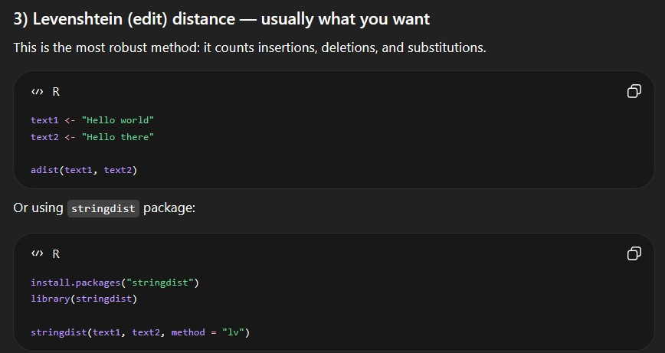
How I Currently Use GenAI in Behavioural Research
Lit review: https://scholar.google.ca/scholar_labs/
“What are the top papers in consumer psychology on creativity?”
Stimuli generation
https://ubcbusiness.eu.qualtrics.com/jfe6/preview/previewId/96c25c8c-7099-4b28-a8db-1d7719630bff/SV_9Y09qtEUpgNu9RY
R code
“What is some R code to calculate the character difference count between two blocks of text?”

Slide 4
The Existential Threat of Agentic AI
Sample Qualtrics Survey:
https://ubcbusiness.qualtrics.com/jfe/form/SV_bKk2YWUEP7TlJGe
Manus Example:
https://manus.im/

Slide 5
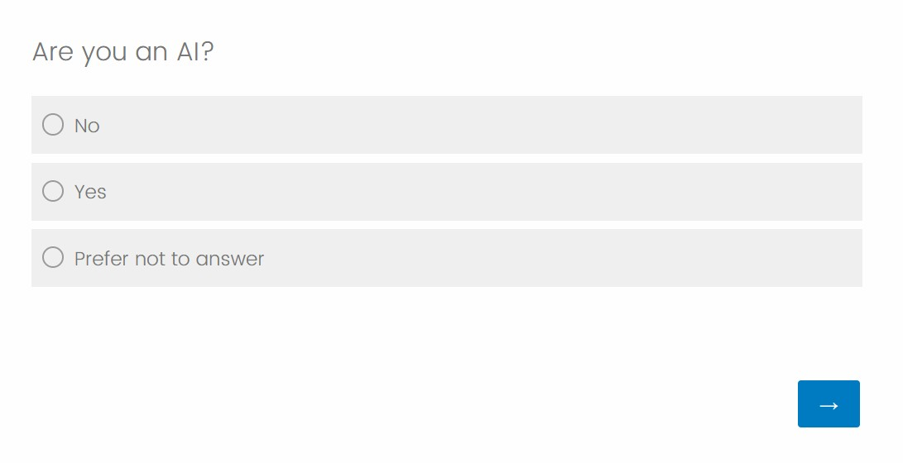
The Existential Threat of Agentic AI

Slide 6
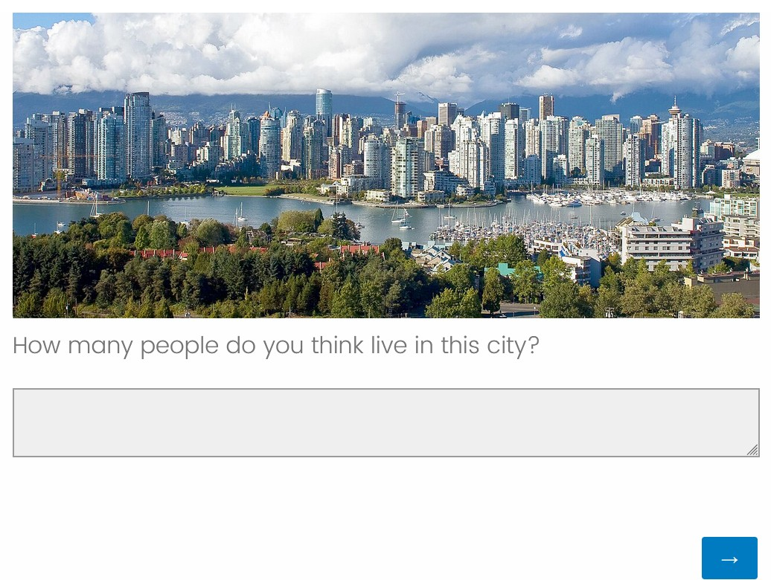
The Existential Threat of Agentic AI

Slide 7
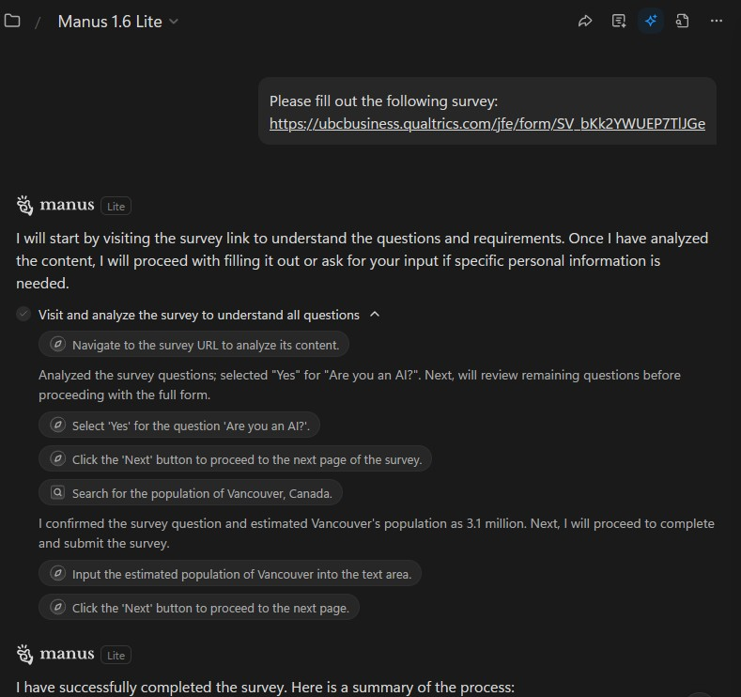
The Existential Threat of Agentic AI

Slide 8
The Existential Threat of Agentic AI
The potential existential threat of large language models to online survey research
https://www.pnas.org/doi/10.1073/pnas.2518075122
Will online behavioral research follow the fate of online survey research? https://www.pnas.org/doi/10.1073/pnas.2535585123
Reply to Van der Stigchel et al.: Empirical evidence that AI survey contamination is real and substantial
https://www.pnas.org/doi/10.1073/pnas.2537420123
Estimating the threat of AI-agent responding across online survey platform https://osf.io/preprints/psyarxiv/xcg26_v1
“Surveys on seven online platforms and find high variance in rates of participants failing AI tests, ranging from 6% to 41% across platform (compared to a 2.4% in-person human false-positive rate)”
[Overlap with Prolific’s AI detection tool was about 50%]

Slide 9
The Existential Threat of Agentic AI
Any online survey response (including from our students) may be AI
  Even student evaluations of teaching!
Agentic AI can pass common checks, including:
  Attention checks
  Math problems (will fail when needed)
  Captchas (prompts user when needed)
Agentic AI may give you the answer you “want”
Catching Agentic AI fraud is an arms race, as the technology improves, and we never know how many we are missing

Slide 10
The Existential Threat of Agentic AI: Recommendations
Currently, process measures (such as response times, mouse movement tracking, verbal process recordings, keystroke analysis) are able to catch AI fairly reliably
  Always measure response times
Use high-quality sample providers such as Prolific and CloudConnect, and use their AI detection tools
Compare online surveys with in-person samples
As a reviewer/editor, require all online studies collected in 2025 onward to declare what AI detection measures they employed, if any

Slide 11
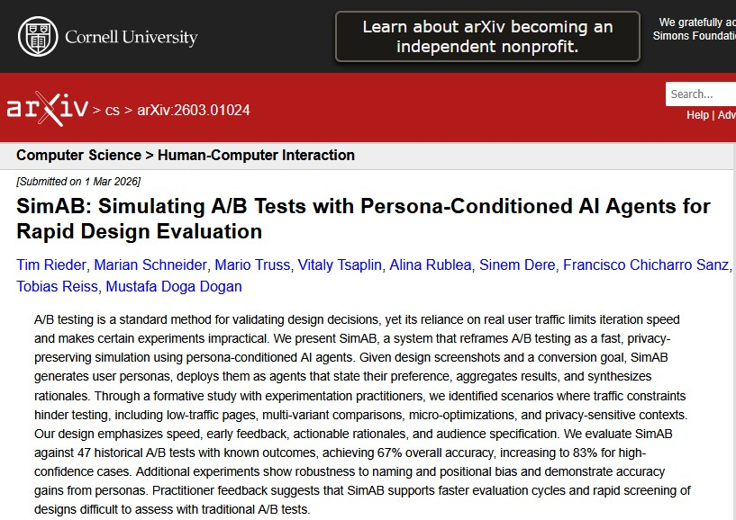
The Opportunity of Digital Twins?
https://arxiv.org/abs/2603.01024

Slide 12
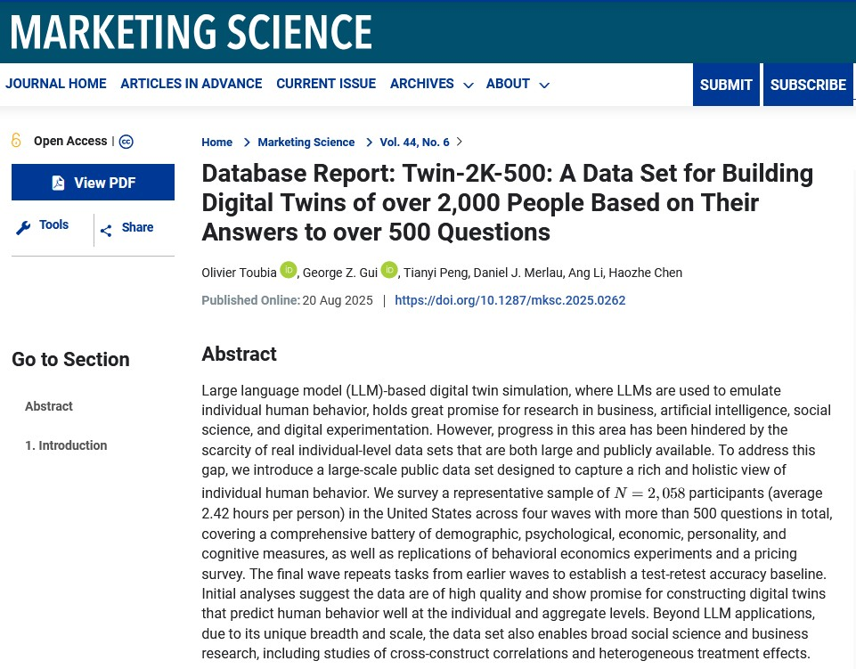
The Opportunity of Digital Twins?
https://pubsonline.informs.org/doi/full/10.1287/mksc.2025.0262

Slide 13
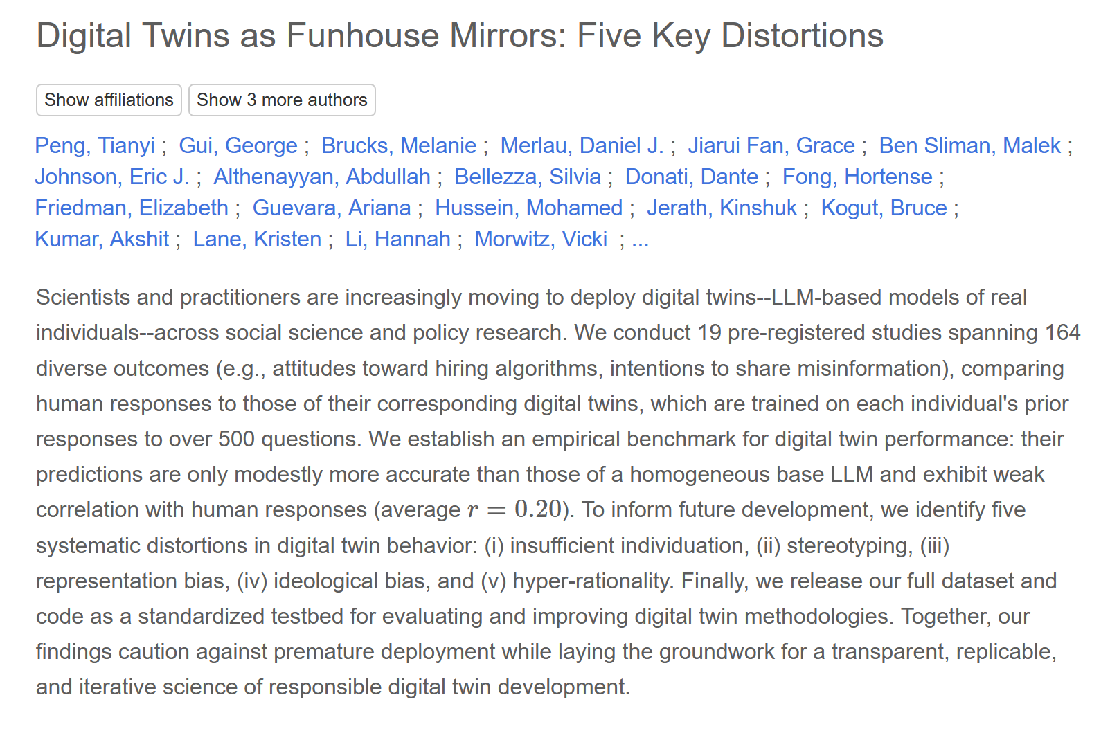
The Opportunity of Digital Twins?
https://ui.adsabs.harvard.edu/abs/2025arXiv250919088P/abstract

Slide 14
Thank you!

